Slide 1
Fanlinc
Presented by TeamOf7
Cheng Gao
Diego He
Hongming Li
Jiasong Liang
Chengyu Xin
Xinzheng Xu

Slide 2
Product Introduction - Fanlinc
Objective:
provide a platform for fans who share the same interest to forge meaningful connections between one another as well as assist them to hold events so that they can branch out their fandom, and enhance their relationship regardless of distance.
Notes:
Introduction of Project: the project that we made is a social web application called Fanlinc, the objective of Fanlinc is to provide a platform for fans who share the same interest to forge meaningful connections between one another as well as assist them to hold events so that they can branch out their fandom, and enhance their relationship regardless of physical distance.

Slide 3
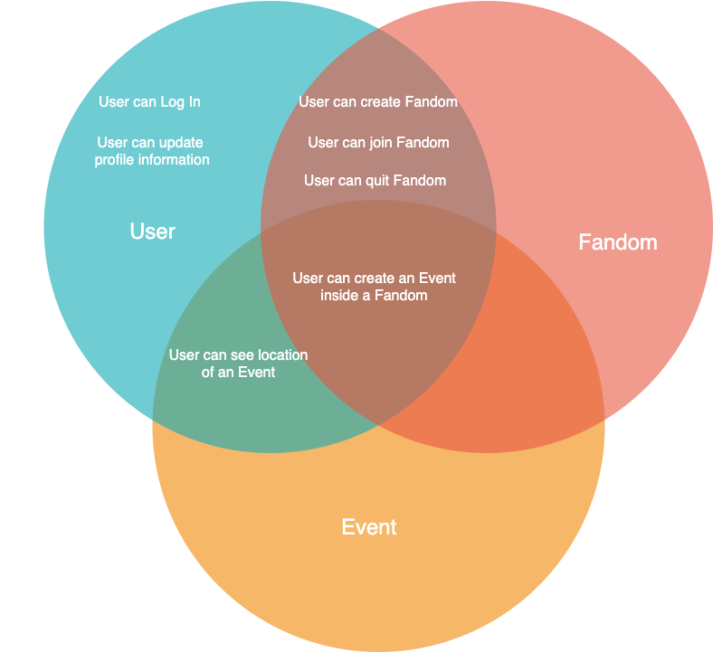
Fanlinc
Three fundamental elements:
User
Fandom
Event
Notes:
Fanlinc consist of three fundamental elements which are User, Fandom and Event. And as a client of our application, they can register an account, login as user, update their profile information and a set of operations as shown as the intersection area of the three elements.

Slide 4
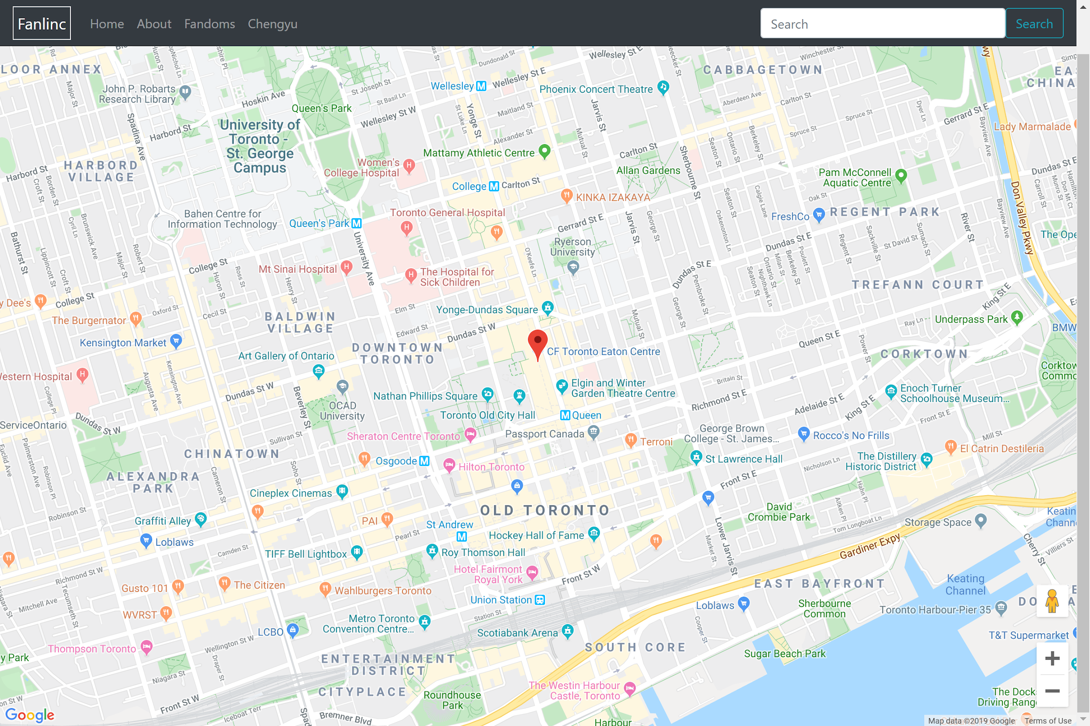
Feature #1
Display event location
Mark on map to help users find the location easily.
Map
Notes:
Now let’s move to our next slide to talk about the features that our Fanlinc has, the first feature that comes to our sight is the rich, accurate real-time Map. Thanks to Google Map API it provides users geographical information of an event and helps user to find the location more easily

Slide 5
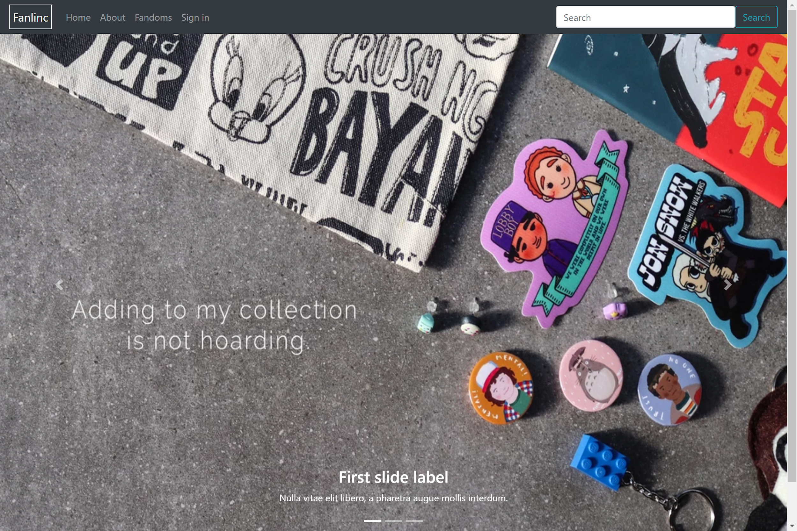
Feature #2
Nice and clean layout
Effective Navigation
Contrasting Colour Scheme
Front End Design
Notes:
The next feature will be our front-end design, our web page is clean and neat, the navigation bar utilized all the functionalities of our application. The search bar is clearly displayed in the navigation bar at the top right corner. User can easily find it when browsing our website. The font size and colour are also very intuitive to follow and read.

Slide 6
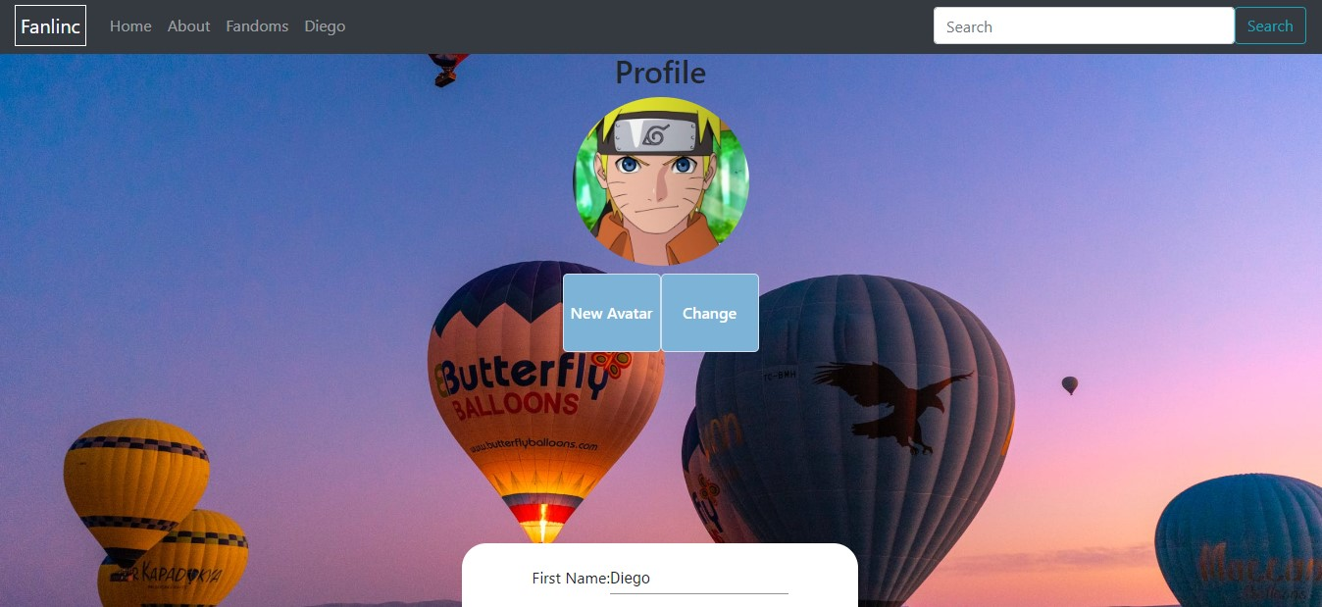
Feature #3
Frontend web page can render image from Cloud Storage
Allow user use customized picture as their avatar
Image Synthesis
Notes:
Last but not least, our application provides users a Cloud Storage to upload files such as their profile picture, and the front-end web page is able to synchronize with the Cloud and render the corresponding image at the correct location.

Slide 7
Demo Time
Let’s have a look at our website!

Slide 8
Team Introduction
Front End
Back End
Diego He
Jiasong Liang
Chengyu Xin
Cheng Gao
Hongming Li
Chengyu Xin
Xinzheng Xu
Notes:
Our team is divided into two parts: frontend and backend, at the later stage, some members are switching from backend to frontend as we realized frontend has heavier workload than backend.

Slide 9
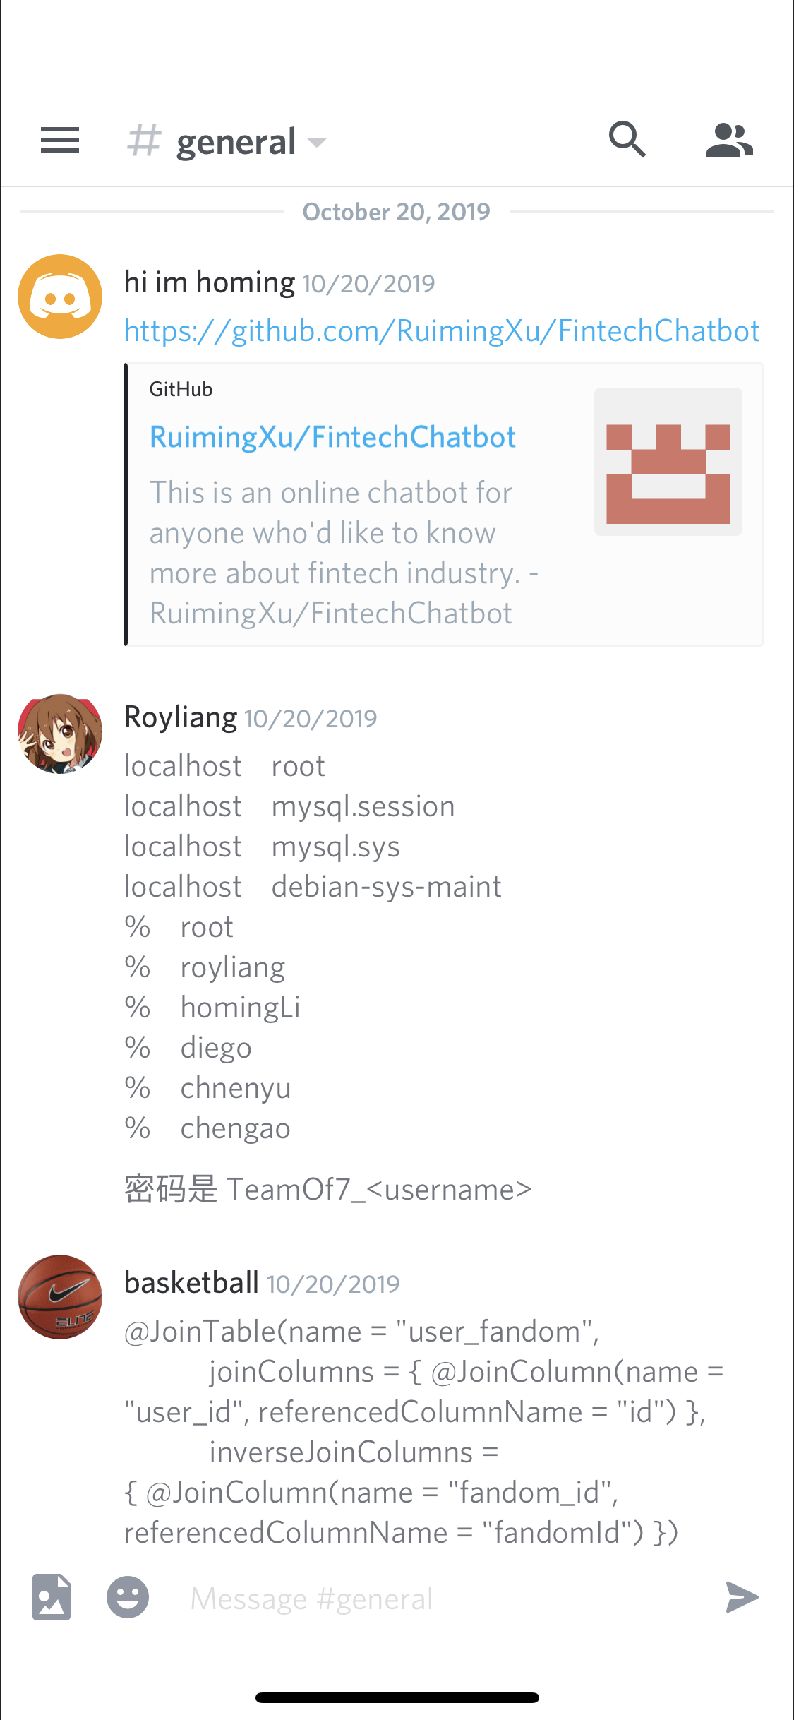
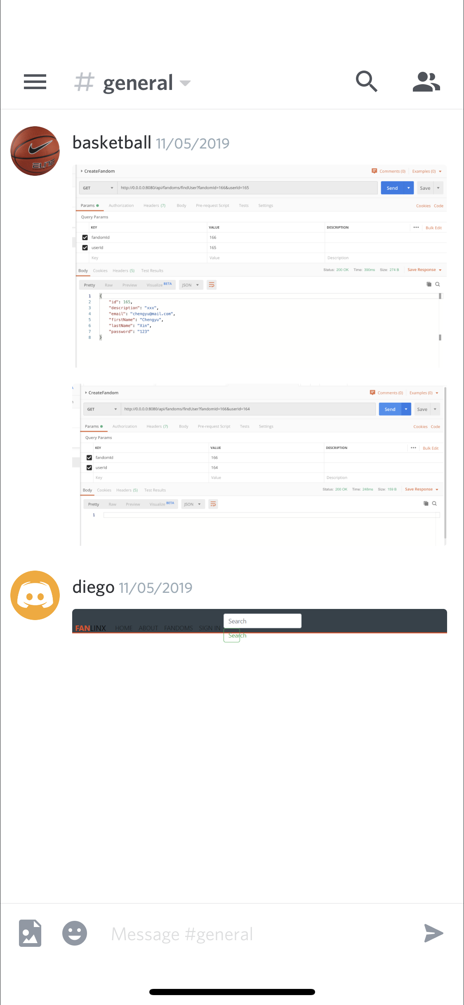
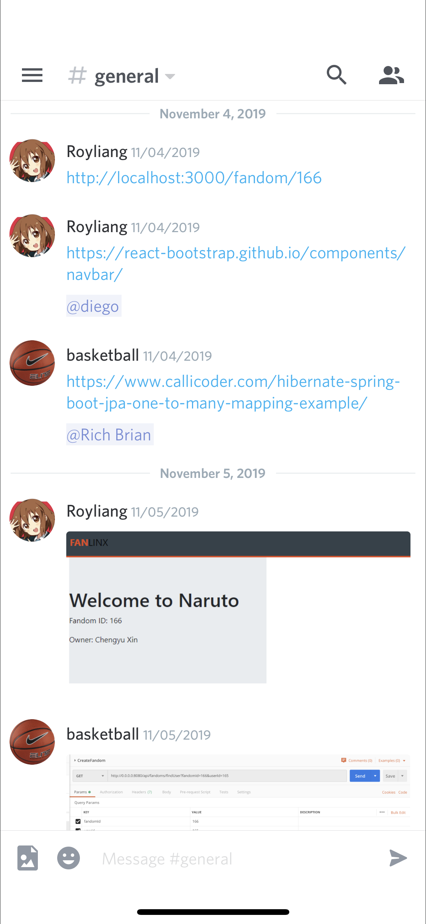
Team Communication - Discord
Discussion
Online Resource Sharing
Notes:
The way that our team communicates is mainly through discord voice chat, the screenshots you saw are how we share online resources, HTTP request response body and codes for discussion.

Slide 10
Processes
Backend:
Data is calculated and successfully recorded
Relationship is established without error
Frontend:
Data can be retrieved from back end
Page is rendered with desired layout and correct information
Notes:
Next, let’s talk about how the application was developed, as we said before, our team is divided into frontend and backend team, the main goal for backend is to design all the web api and to calculate data, give required result and save it to the database. Another task is to establish correct relationships between different entities. As for frontend, the major task is to successfully retrieve data from our database and render them correctly as a web page.

Slide 11
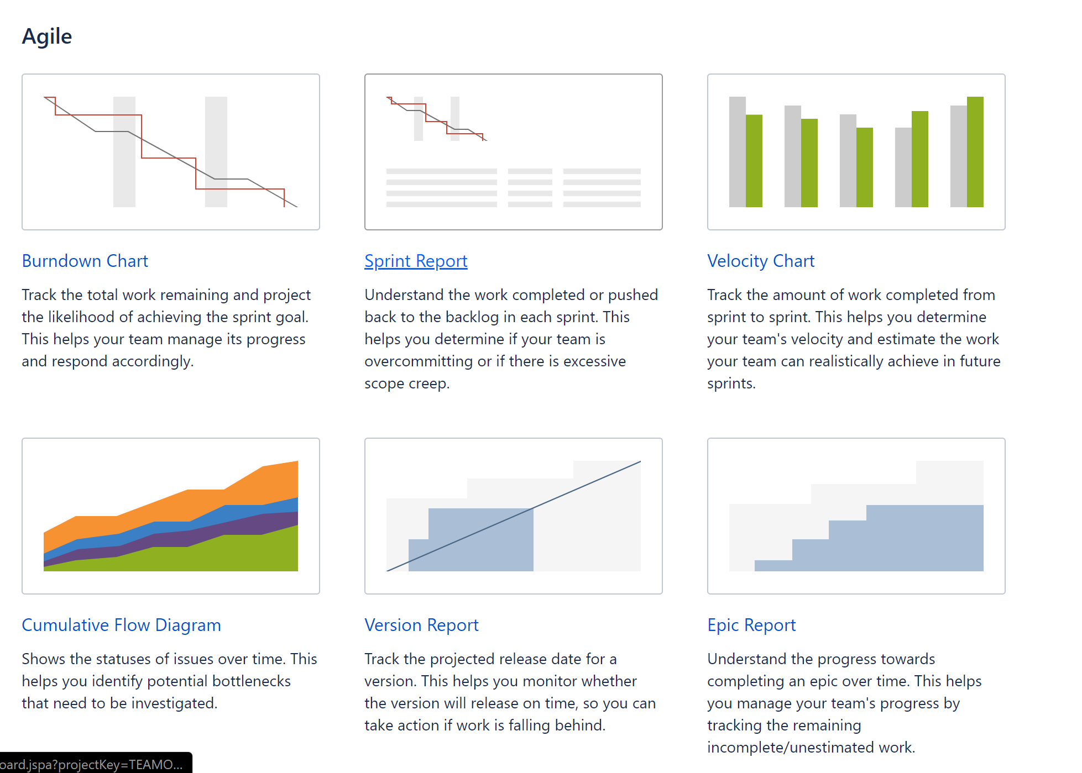
Processes - Agile
Using Jira to keep track of all the progress
Notes:
We used Agile as our software development approach, we have 4 sprints in total and all of our progress is recorded on Jira, Jira provides many useful graphs that elaborates the details of each sprint. Below are some screenshots that illustrate how tasks are done in each sprint.

Slide 12
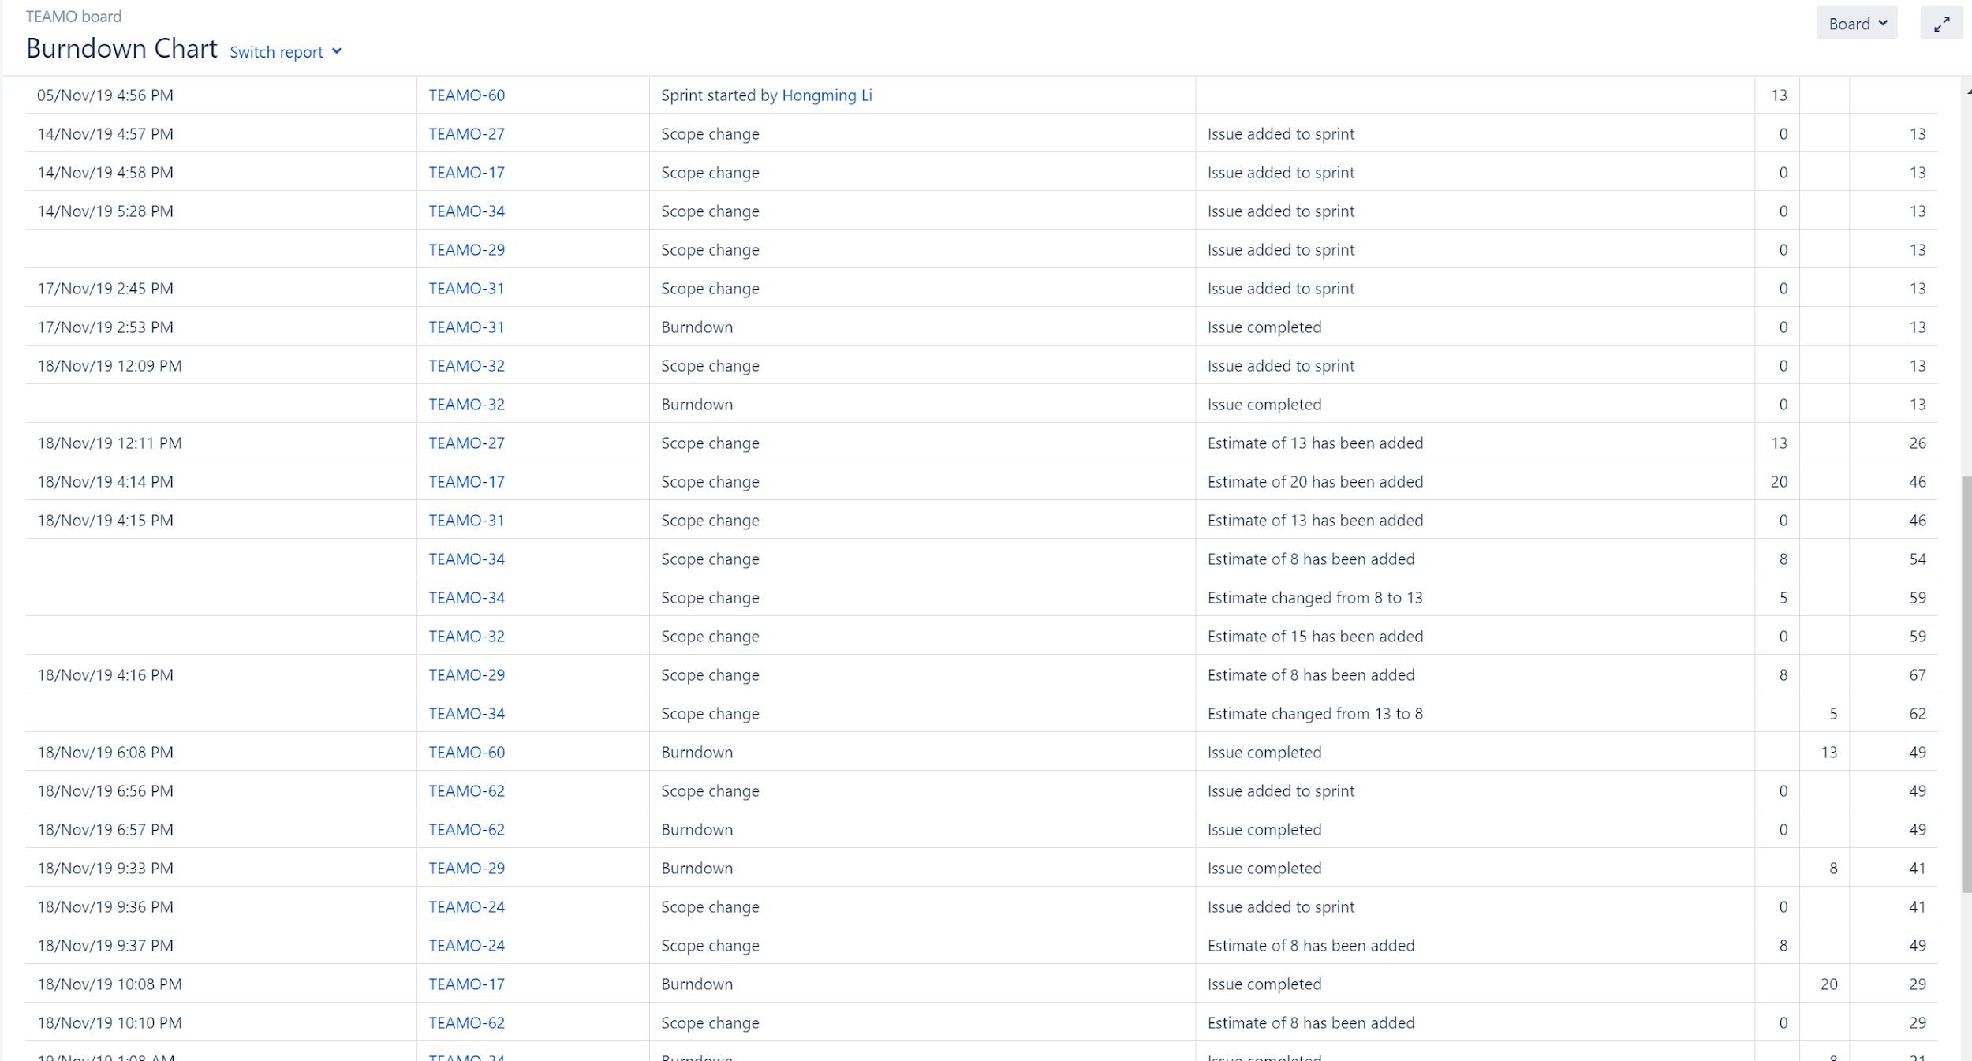
Processes - Agile (Burndown Chart)
All actions are recorded on Jira

Slide 13
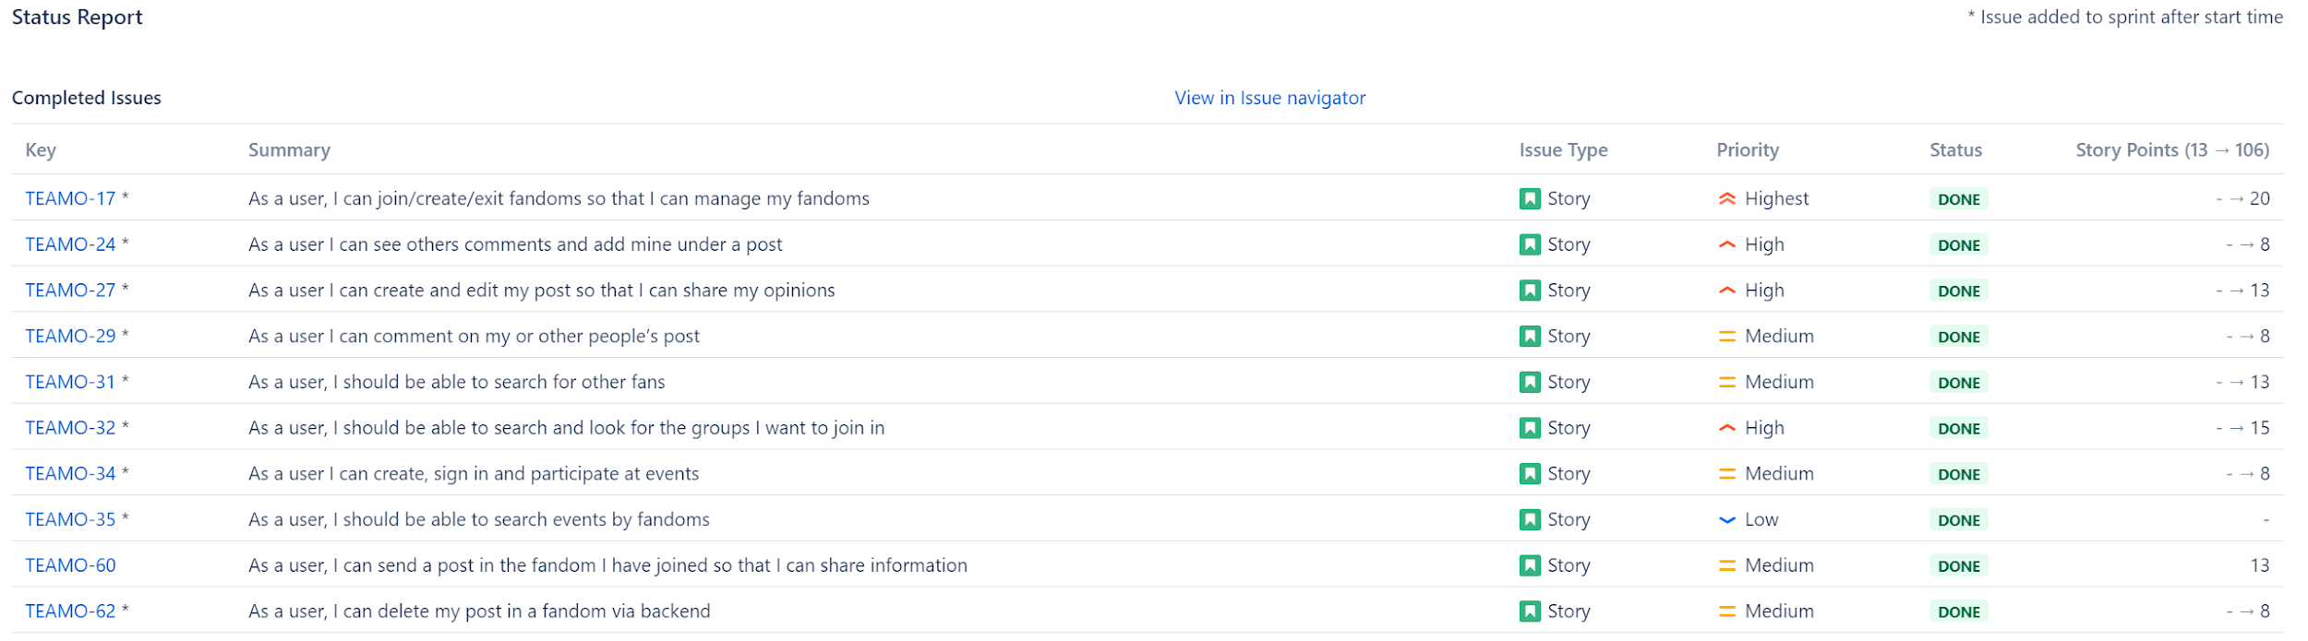
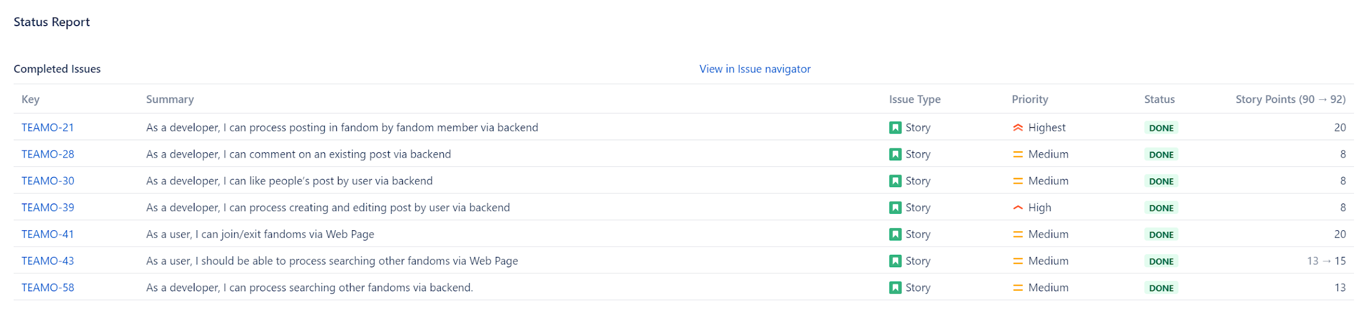
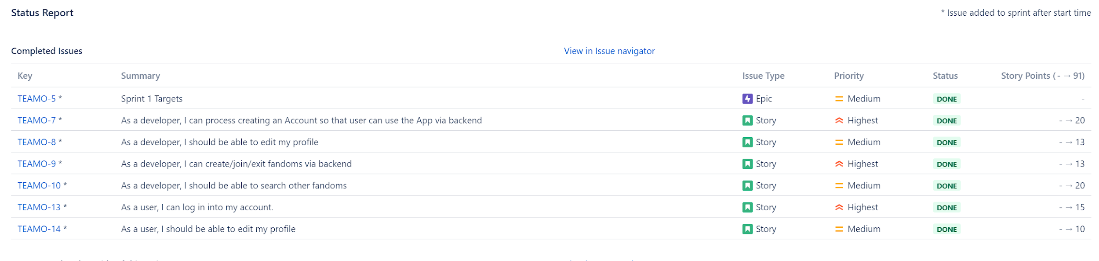
Processes - Agile (Sprint Report)
Reports for each sprint

Slide 14
Standards
Indentation:
consistent indentation
emphasize the body of a control structure such as a loop or a select statement.
emphasize the body of a conditional statement
emphasize a new scope block
Naming Convention:
camelCase
Notes:
As for standards, the main things that come to our agreement are indentation and naming convention. We require each member to write code with consistent indentation, emphasize the body of a control structure such as a loop statement, emphasize the body of a conditional statement and emphasize a new scope block. For all the variables, we asked each member to use camelCase naming convention.

Slide 15
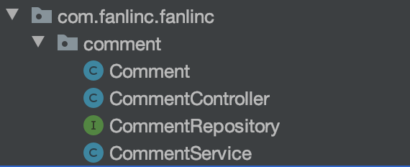
Techniques
Have a general structure for an Object class (e.g the Comment Object)
Each team member works independently but follows the same structure
Notes:
The techniques that we used is that before we start our individual code, we designed a universal code structure and ask every team member to follow this structure. Here is an example of the comment package, each package contains 4 files: the object class, controller class, repository interface and the service class.

Slide 16
Techniques (Cont’d)
Backend knows what data & format will be sent from Frontend and assumes they are valid
Frontend knows what data & format will be sent from Backend and assumes they are valid
Notes:
Beside the code structure, both frontend and backend team know what data & format will be sent from the other end and assumes they are valid, this greatly boosts our speed and efficiency.

Slide 17
Software Architecture

Slide 18
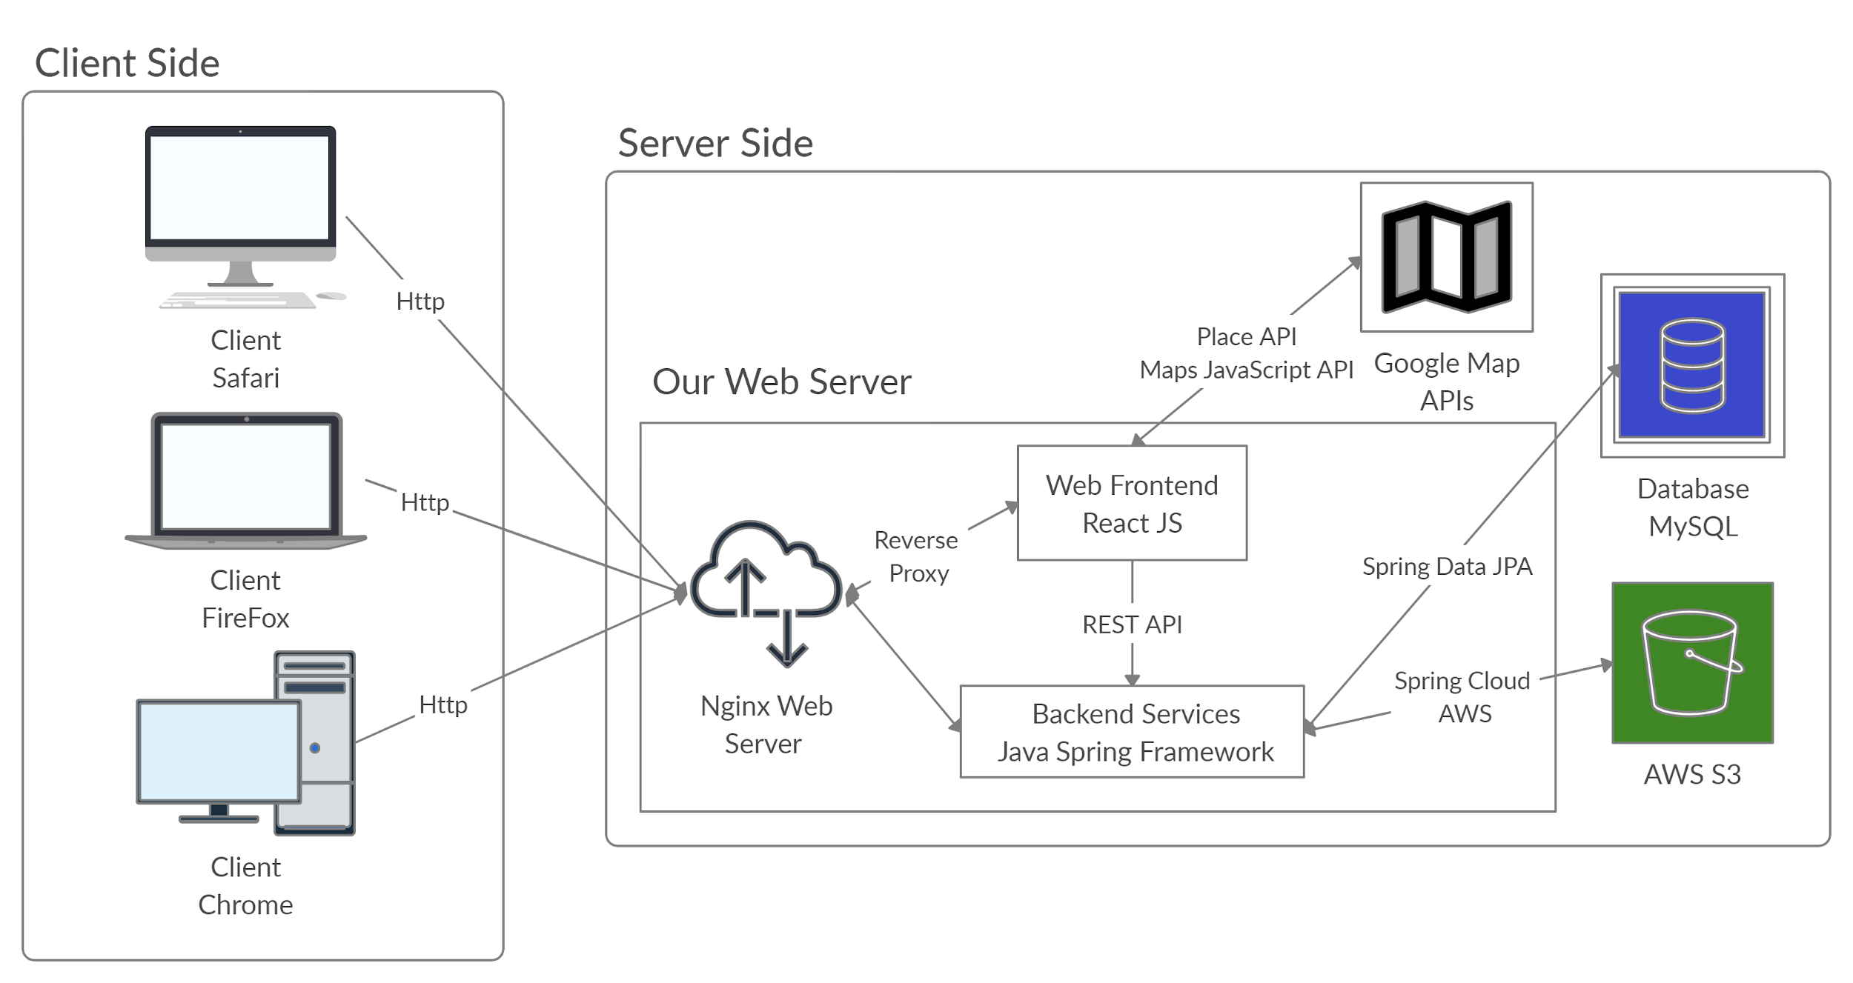
Notes:
Client and Server Model is the underlying architecture that web-based APIs use for exchanging information
The client is a computing device (e.g. a smartphone, laptop, etc.) that makes a request for some computing resource or data. The client's request needs to be formatted in the agreed upon protocol.
The server has data and/or computing resources stored on it. Its job is to interpret and fulfill a client's request.
APIs that utilize the HTTP protocol, request methods, and endpoints are referred to as RESTful APIs.
Endpoints are access points to data or computing resources hosted on a server and they take the form of an HTTP URI

Slide 19

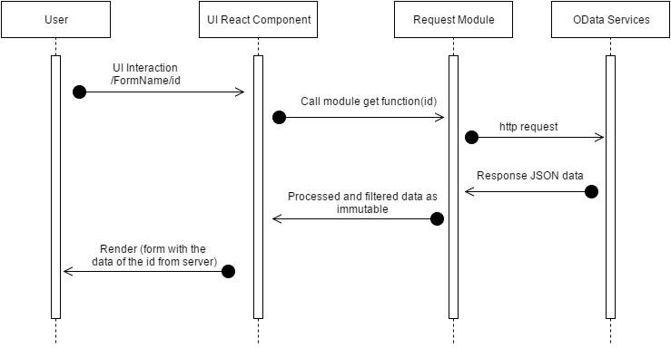
Frontend Technologies Used
React JS - Provide Web UI to let users uses the functions and retrieve data from backend with REST API

Slide 20

Backend Technologies Used
Backend Service:
Postman - Allow Backend to test if the api works;
Java Spring Framework - REST Controllers to accepts requests and services to process data.

Slide 21
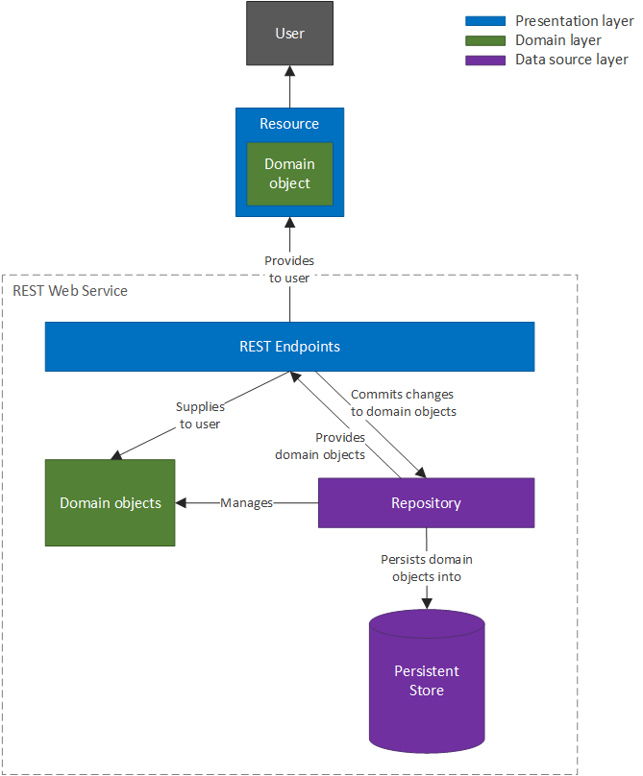

Slide 22


Technologies Used (Cont’d)
Data Persistence:
MySQL - Store traditional relational information, i.e. profiles and event records;
AWS S3 - Store files which are difficult to store in the traditional RDBM, i.e. images
Third Party Data Source: Allow web to access to external data simply uses reference instead of saving it in our database.
Google Map APIs - Provides location info and web js map on our site

Slide 23
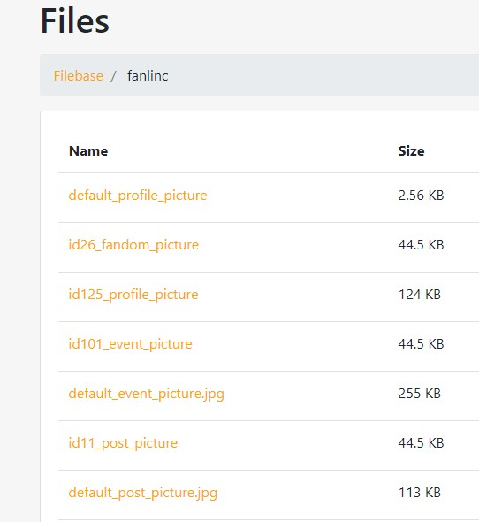
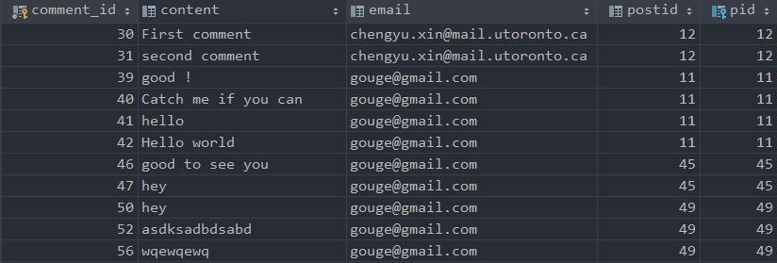
Notes:
A group of screen

Slide 24
Technical Challenges
Lack of Familiarity and Experience (Frontend & Backend)
Database Synchronization
Establish Relationship Between Entities
Frontend Framework
Storage of image files

Slide 25
Thank You

